Slide 1
Knightly Knockout

Slide 2
TABLE OF CONTENTS
Game Description
Completed prototype demo key points
01
02
What is the game
What points have been completed and how

Slide 3
Game Description
01

Slide 4
Knightly Knockout is a first person 1v1 swordfighting game. The first player to win 3 round wins.
The game will be networked multiplayer.

Slide 5
Completed prorotype features

Slide 6
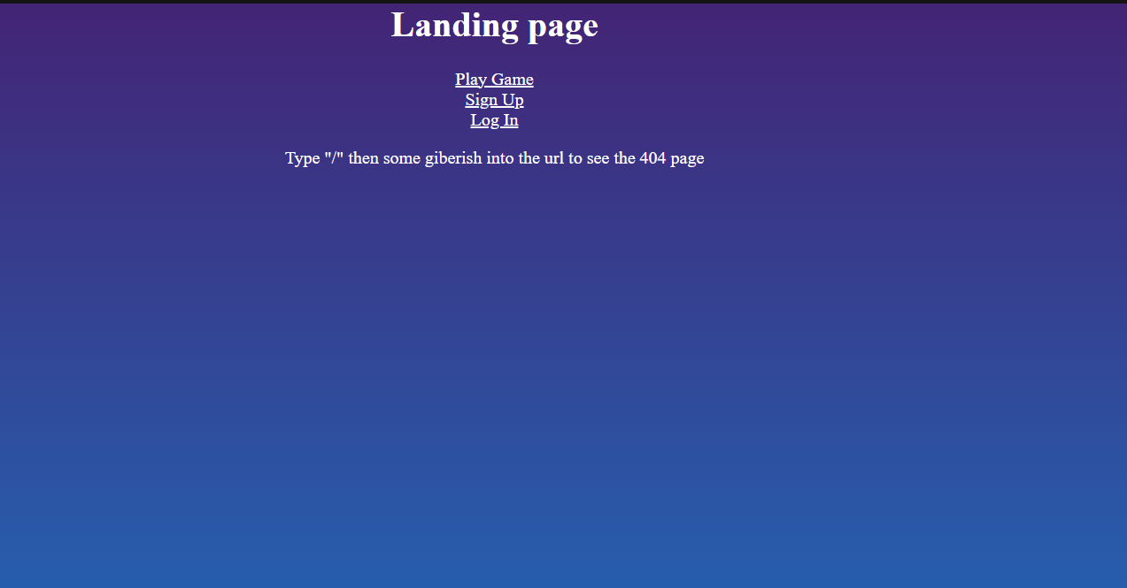
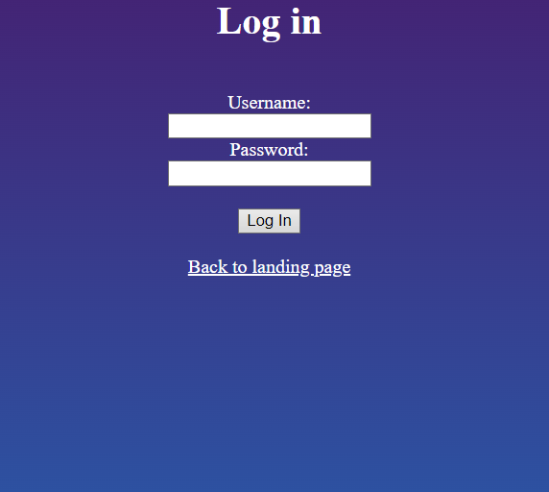
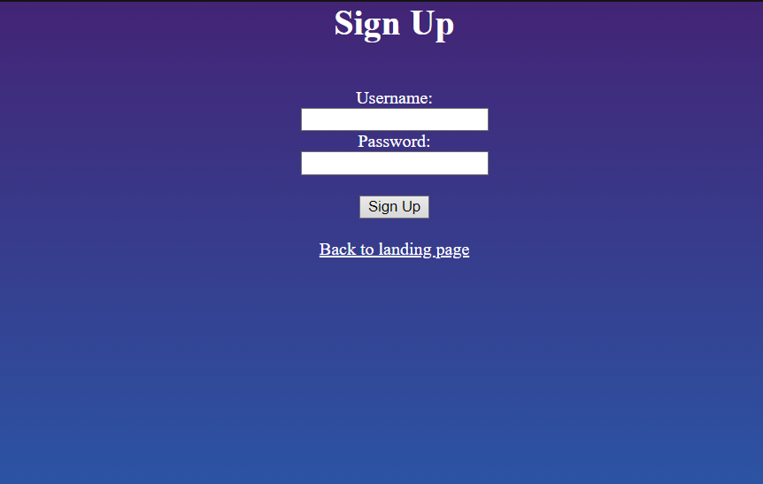
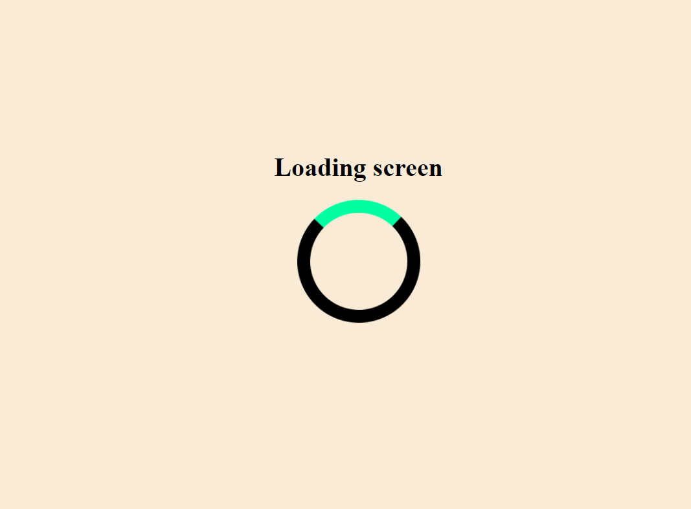

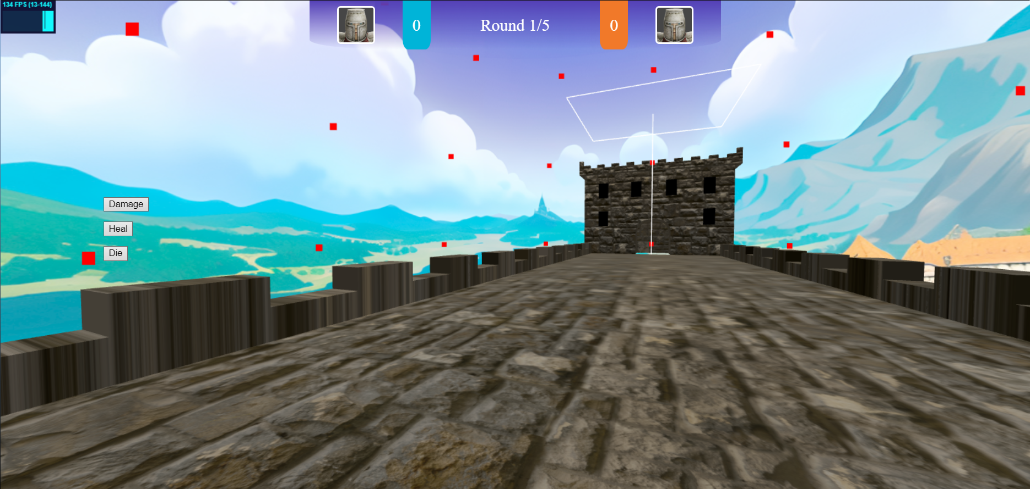
Completed features
Game websites design (client-side only): has Introduction page, Login page, New user register page, 404 page, game loading page and game pages.

Slide 7
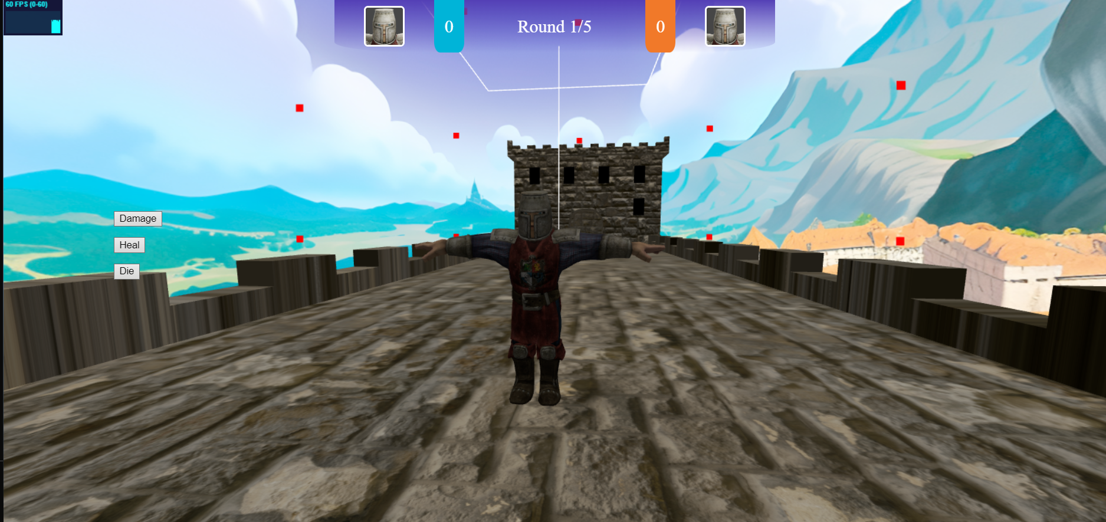
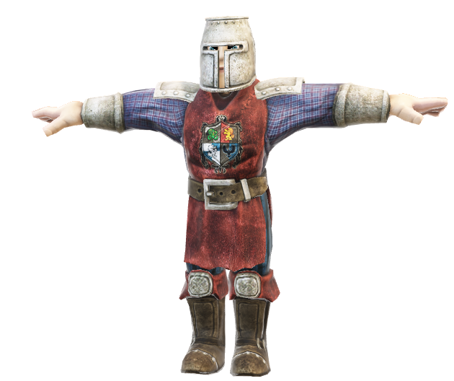
Completed features
Game assets: for example, character, landscape/environment and enemy design (if applicable).
Player/enemy character:
Castle Bridge environment:

Slide 8
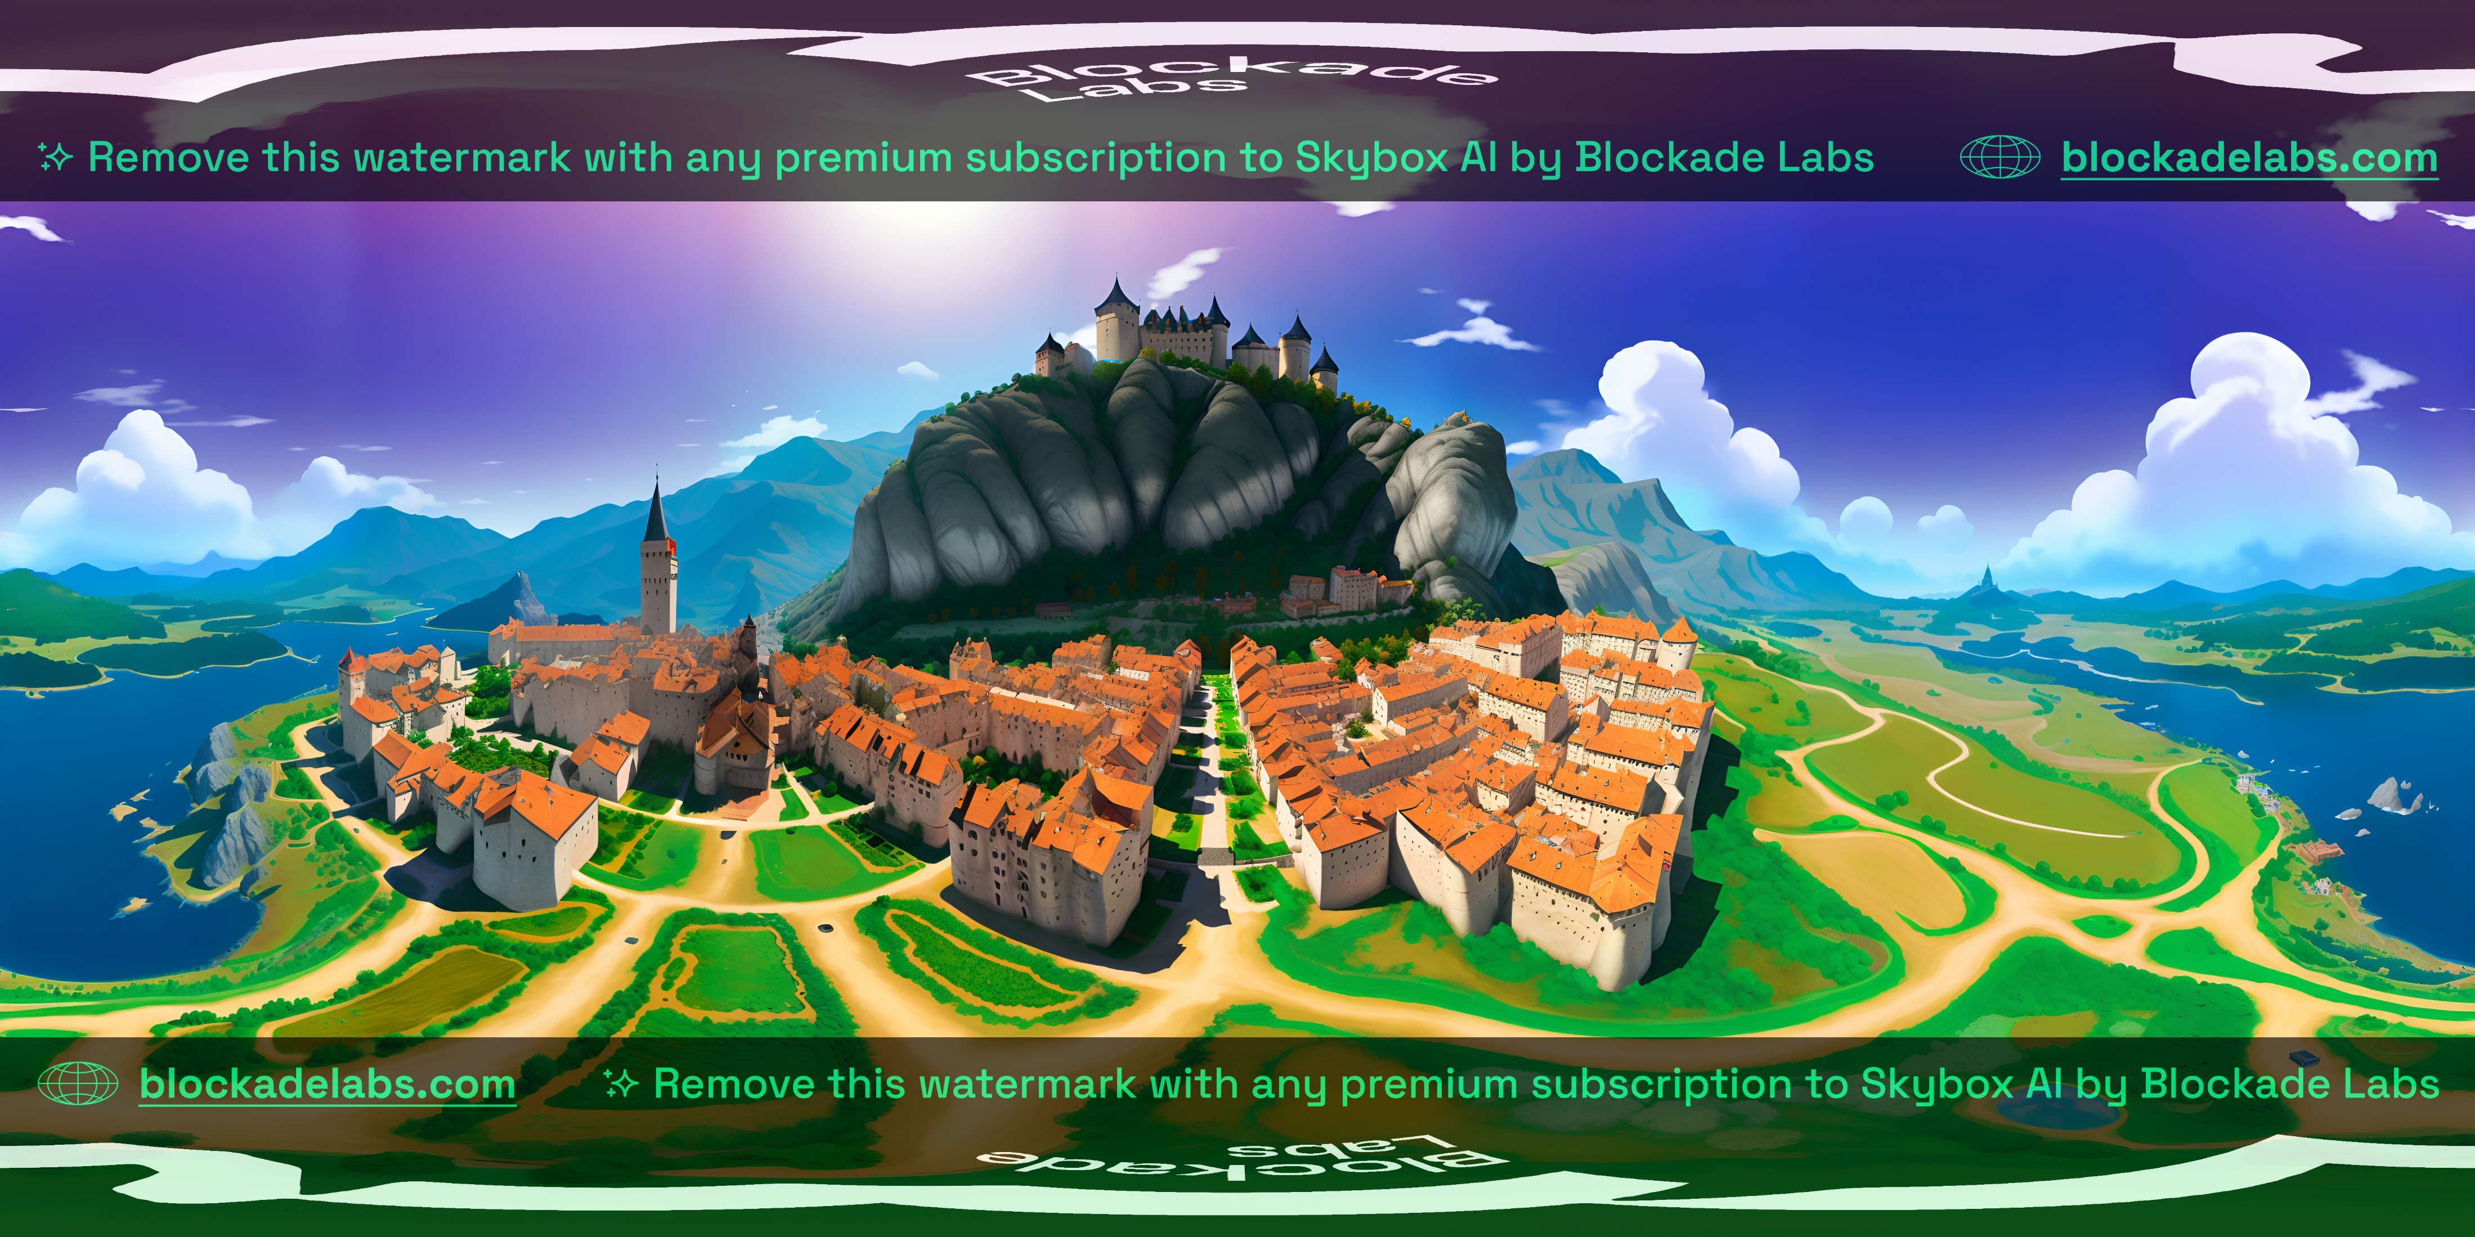
Completed features
Game material design: light, texture, material for the game assets
The player and the bridge both have textures which are packaged as part of the gltf file, additionally the cloud meshes generaged in the sky have lambert materials on them
As for lighting a directional light is used to light the scene.
An image texture is used to create the skysphere, giving the game a background

Slide 9
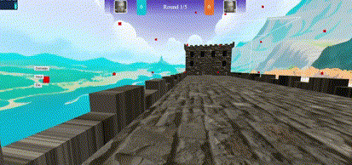
Completed features
Game animation: animation of game assets
Animation of game assets is shown whenever the player moves, their character is translated and moved through the scene

Slide 10
Completed features
Game interaction: user interaction with the game object
Interaction is done through the WASD keys, this makes the player move forwards, backwards, left and right.
Additionally the damage, heal and die buttons can be used to alter the players health, which can cause them to die, updating the state of the game as the enemy player will get a point

Slide 11
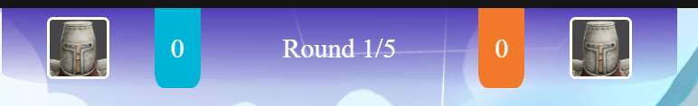
Completed features
Game UI: UI overlay on the web game for scores and life state etc.
Scores are displayed at the top of the screen, this is implemented entirely in css and html using css grid and flexbox so the scoring element is able to resize. The scores section is split into client, center and enemy.
When a player dies the opposing players score is increased and the round counter increases
Client section
Middle section
Enemy profile picture
Client profile picture
Current round
Enemy section
Enemy score
Client score

Slide 12
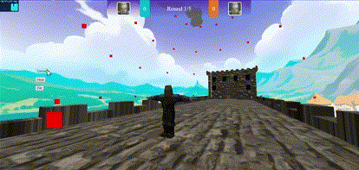
Completed features
Game UI: UI overlay on the web game for scores and life state etc.
Initially the life state of the player was going to be shown through a health bar. However it didn’t look right and was too intrusive on the ui.
Alternatively blood overlay is placed over the screen and its opacity is increased in sync with the players health. This is much more immersive, diagetic and also means the player doesn’t know their exact health which I like as it adds a guessing element and can help build tension.

Slide 13
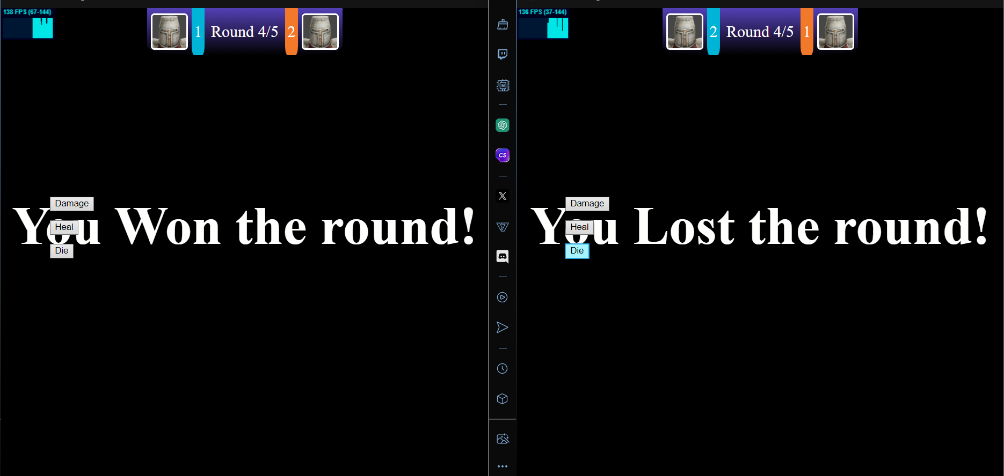
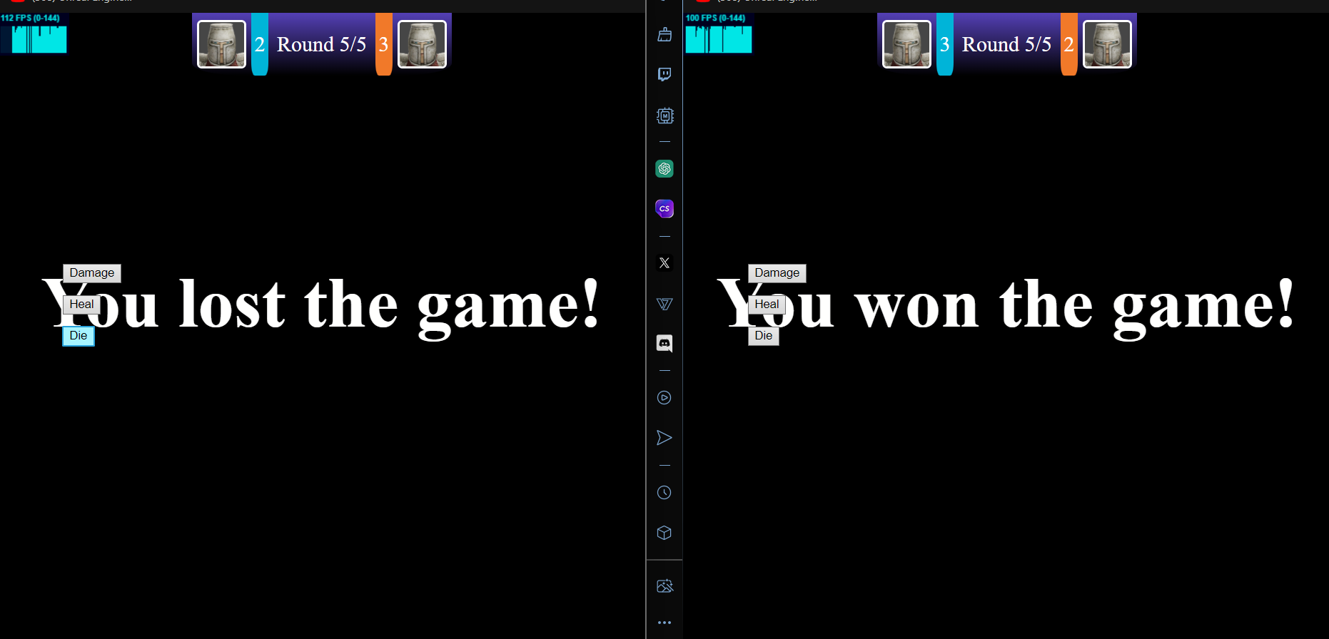
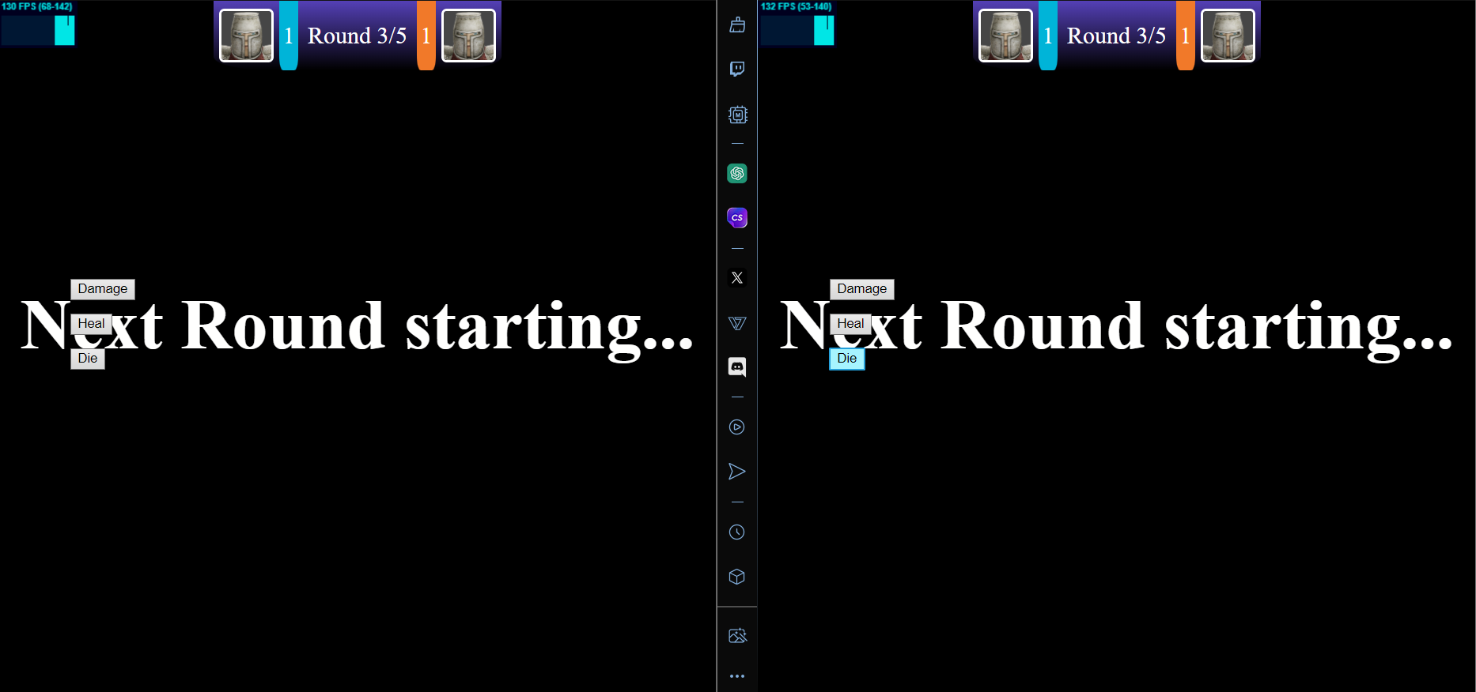
Completed features
Game mechanism: Fully functioning user interface displaying player statistics (i.e. lives or health), scores and rewards / penalties.
As well as player health and scores there are ui elements which display lives, rewards and penalties
The player can see how many lives they have by looking at the enemy players score, if its 0 then the player has effectively 3 lives if the enemies score is 2 then the player only has 1 life left
Lives
When the player wins a round they are met with the you won a round screen, after winning 3 rounds the you won the game screen is shown
Rewards
When the player loses a round they see a you lost the round screen and see the other players score increase by 1, once the other player wins they will see a you lost screen
Penalties

Slide 14
Additional ui
Between rounds a next round starting screen is shown

Slide 15
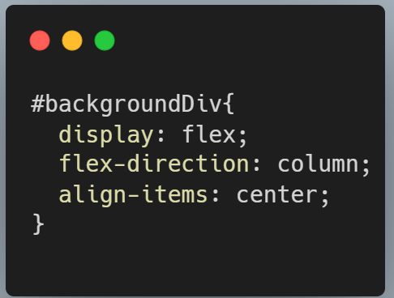
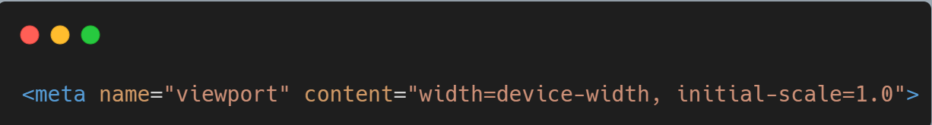
Completed features
Responsive design: the web page and game are rendered according to the window size.
The main content of each webpage is held inside a flexbox container (div) with an id of “backgroundDiv”, using the following lines of css the web pages are able to resize to fit the window. As flexbox is used I believe that this also hits the final demonstration criteria of making the webpages responsive with implementation standards
Additionally the meta tag is set up to allow the window to resize

Slide 16
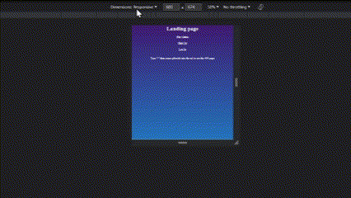
Responsive web design demonstration

Slide 17
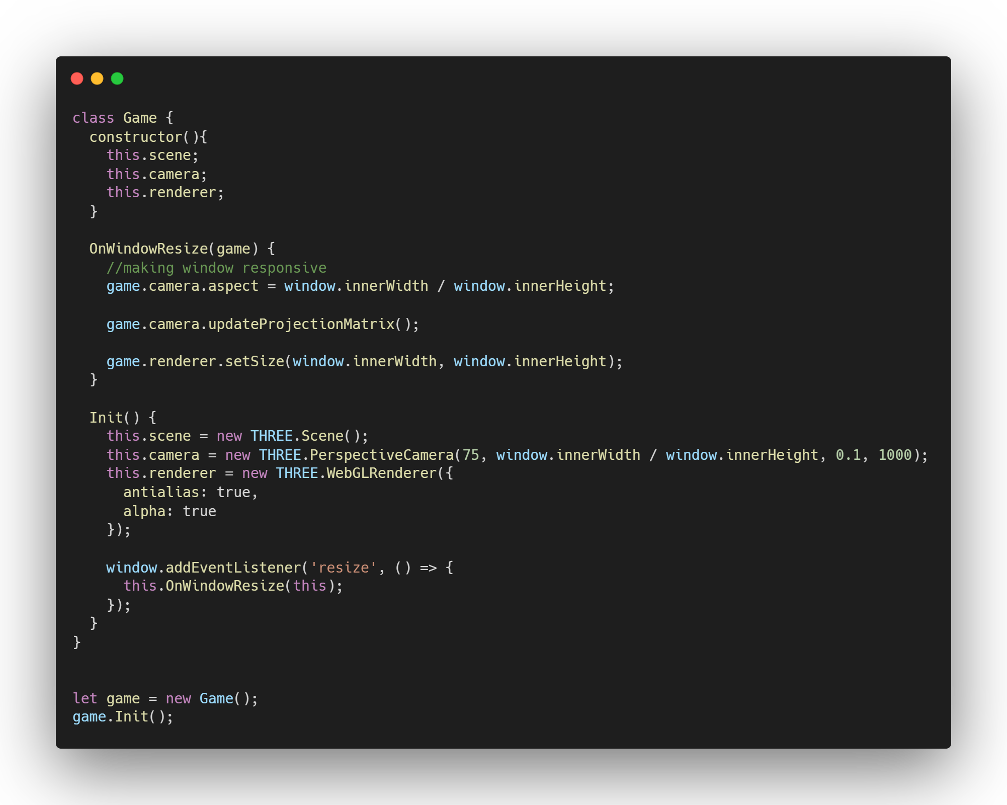
Completed features
Responsive design: the game page is rendered according to the window size.
Here you can see an abstracted version of the Game class.
First the class is declared:
In the class is a constructor which declares the attributes: this.scene, this.camera, this.render.
The OnWindowResize function which takes a game instance as a parameter, does all of the resizing by updating the camera aspect, updating the camera projection matrix and setting the size of the renderer to cover the new screen size

Slide 18
Completed features
Responsive design: the game page is rendered according to the window size. Part 2
The Init function instantiates the scene, camera and renderer to be used later.
Additionally It adds an event listener to the window on resize. A callback function is supplied which calls the on window resize function passing in this instance of the game.
The final section of the code shows a new game being created and then the Init method is called.

Slide 19
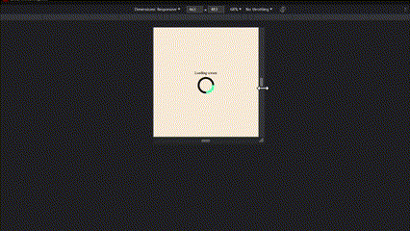
Responsive game demonstration

Slide 20
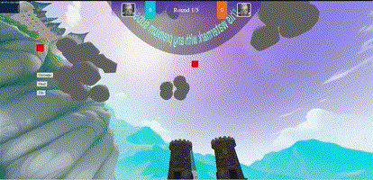
Final demonstration features
Complicated landscape and visual effect display and with a good loading speed: For example, particles and use of instance.
This criteria point is only partially complete. In order to make the webpage performant the use of instance meshes have been used to create the clouds in the game. These clouds are made up from multiple sphere geometries combining together to make more complex geometry clouds

Slide 21
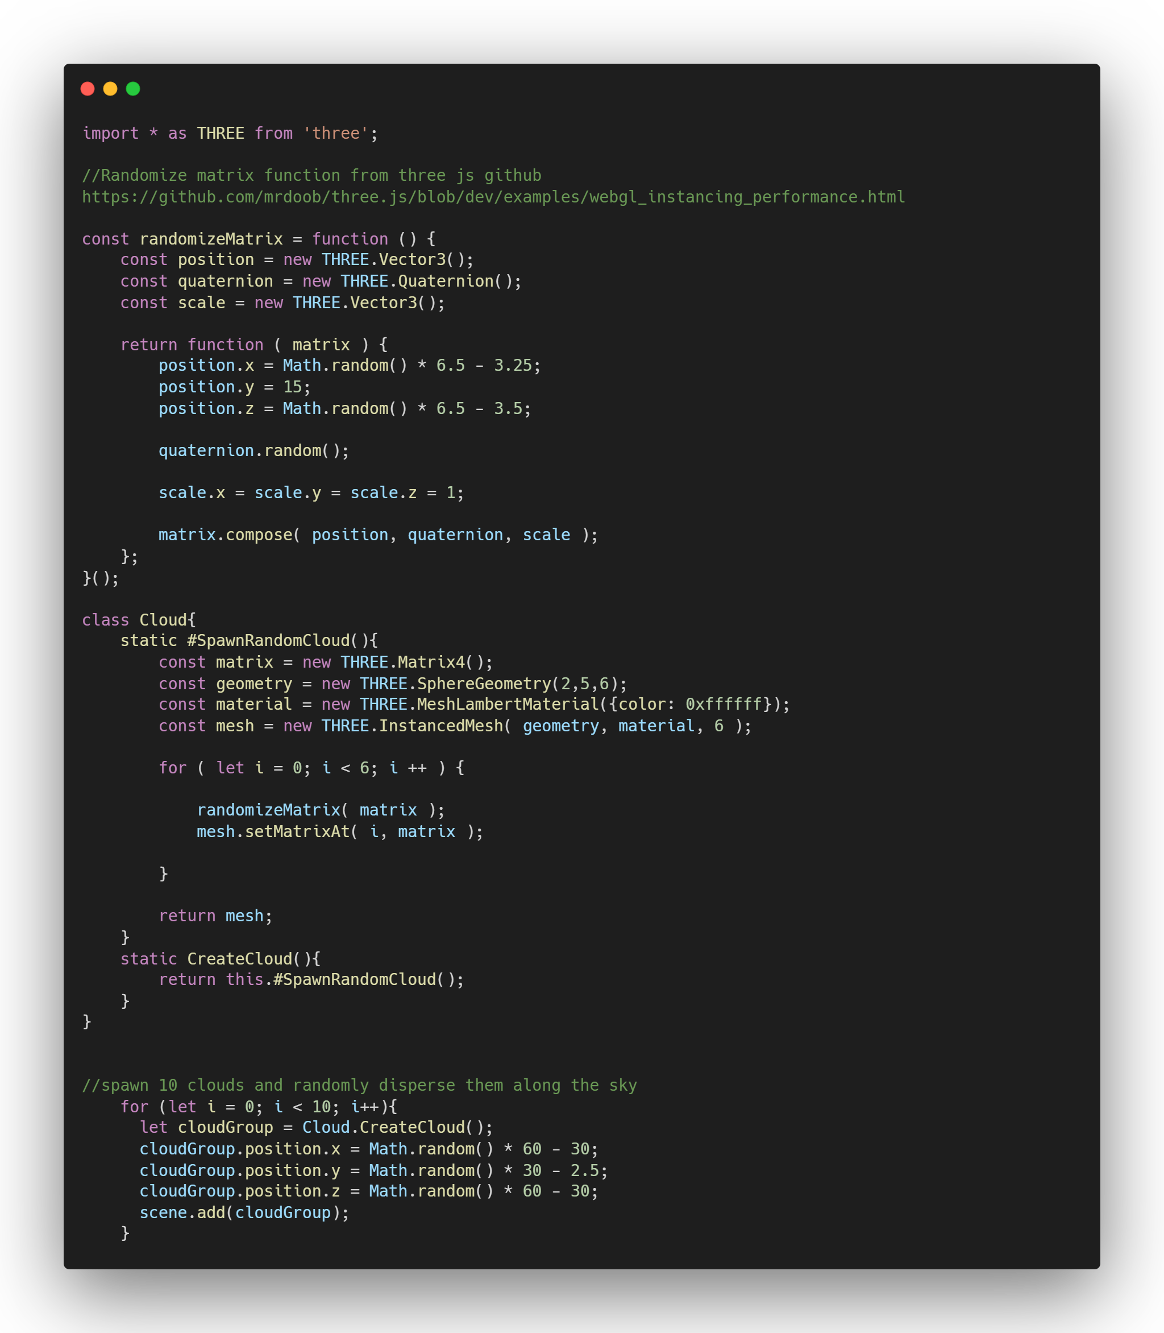
How clouds are spawned
Here is an abstracted version of clouds and how they are spawned into the scene
The randomizeMatrix function creates a matrix of position and rotation (quaternion) where the position x and y are randomized, position y is set to 15 and the rotation is random. It is used to spawn spheres which will be randomly placed in close proximity to each other to make complex but highly performant cloud geometry's
The CreateCloud function returns a group of meshes (cloud) by calling #SpawnRandomCloud and returning its result. The # before the function name makes private functions on the Cloud class. Static means the method can be called without the class being instantiated
The #spawnrandomcloud function makes a new matix and 6 instances of a sphere, it then randomizes the positions of each of these spheres using the randomizeMatrix function
A for loop is run which creates a new cloud group each iteration and randomises the cloud groups position in the sky. Once the position has been randomized the cloud is added to the sky

Slide 22
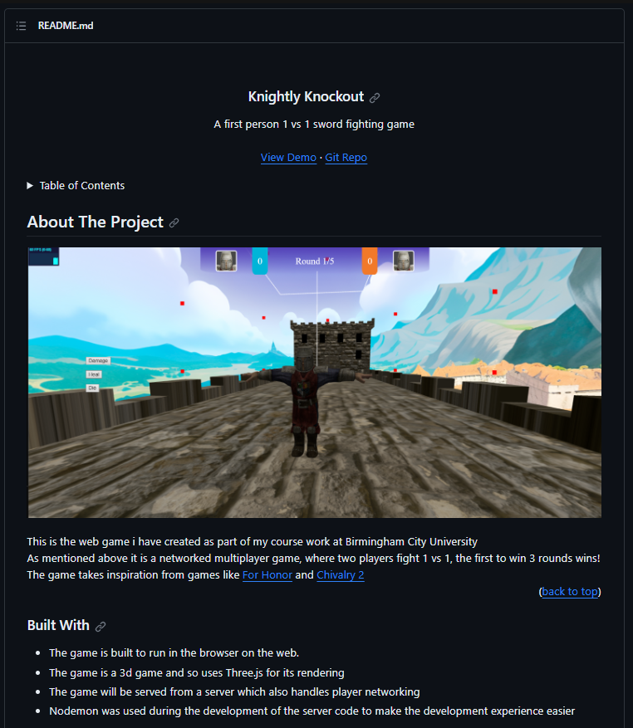
Final demonstration features
Has a "Readme" documentation
If you visit the github repository you can see the readme documentation for the project: https://github.com/JamesB0010/Year2UniWebGame

Slide 23
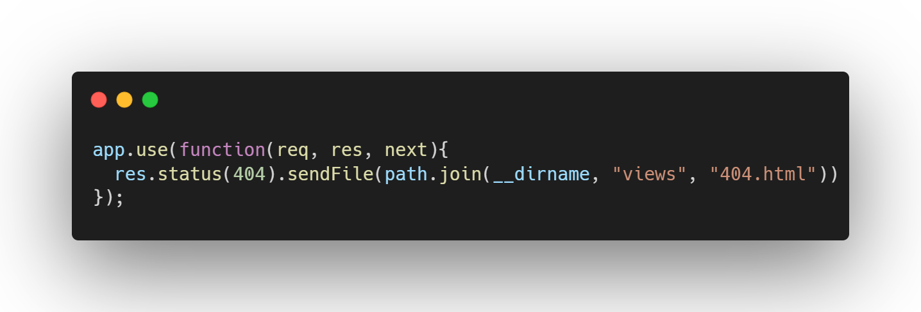
Final demonstration features
404 page is deployed correctly.
Here you can see the 404 page which is returned when a 404 error is returned when trying to get from the server for example if you typed localhost:300/fgsfdgdgfssfdg
This server code responds to a 404 status by serving the 404.html page from inside the views folder. Additionally the accompanying 404css file is served to style the html page

Slide 24
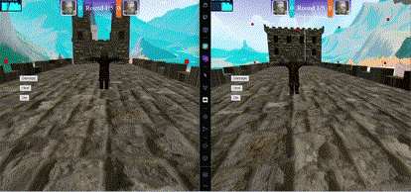
Final demonstration features
Multiple player allows at least two players to play in the same game at the same time
Using socket.io, express and node to run the server I am able to make the game multiplayer. Below shows a test of two clients moving and replicating each others movements first to the server and from the server back to the clients.

Slide 25
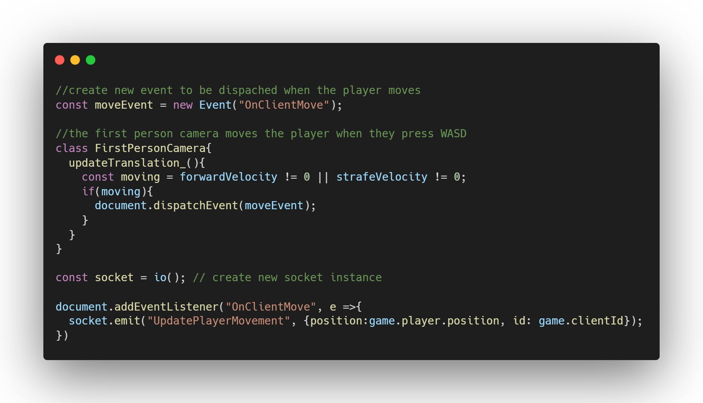
Multiplayer code client sending position
Here is an abstracted version of the client code.
First a new event is created.
Then when the first person camera updates its translation the program checks if the player is moving and if they are the move event is dispatched
This dispatched event is reacted to somewhere else in the program, and the client sends a message to the server

Slide 26
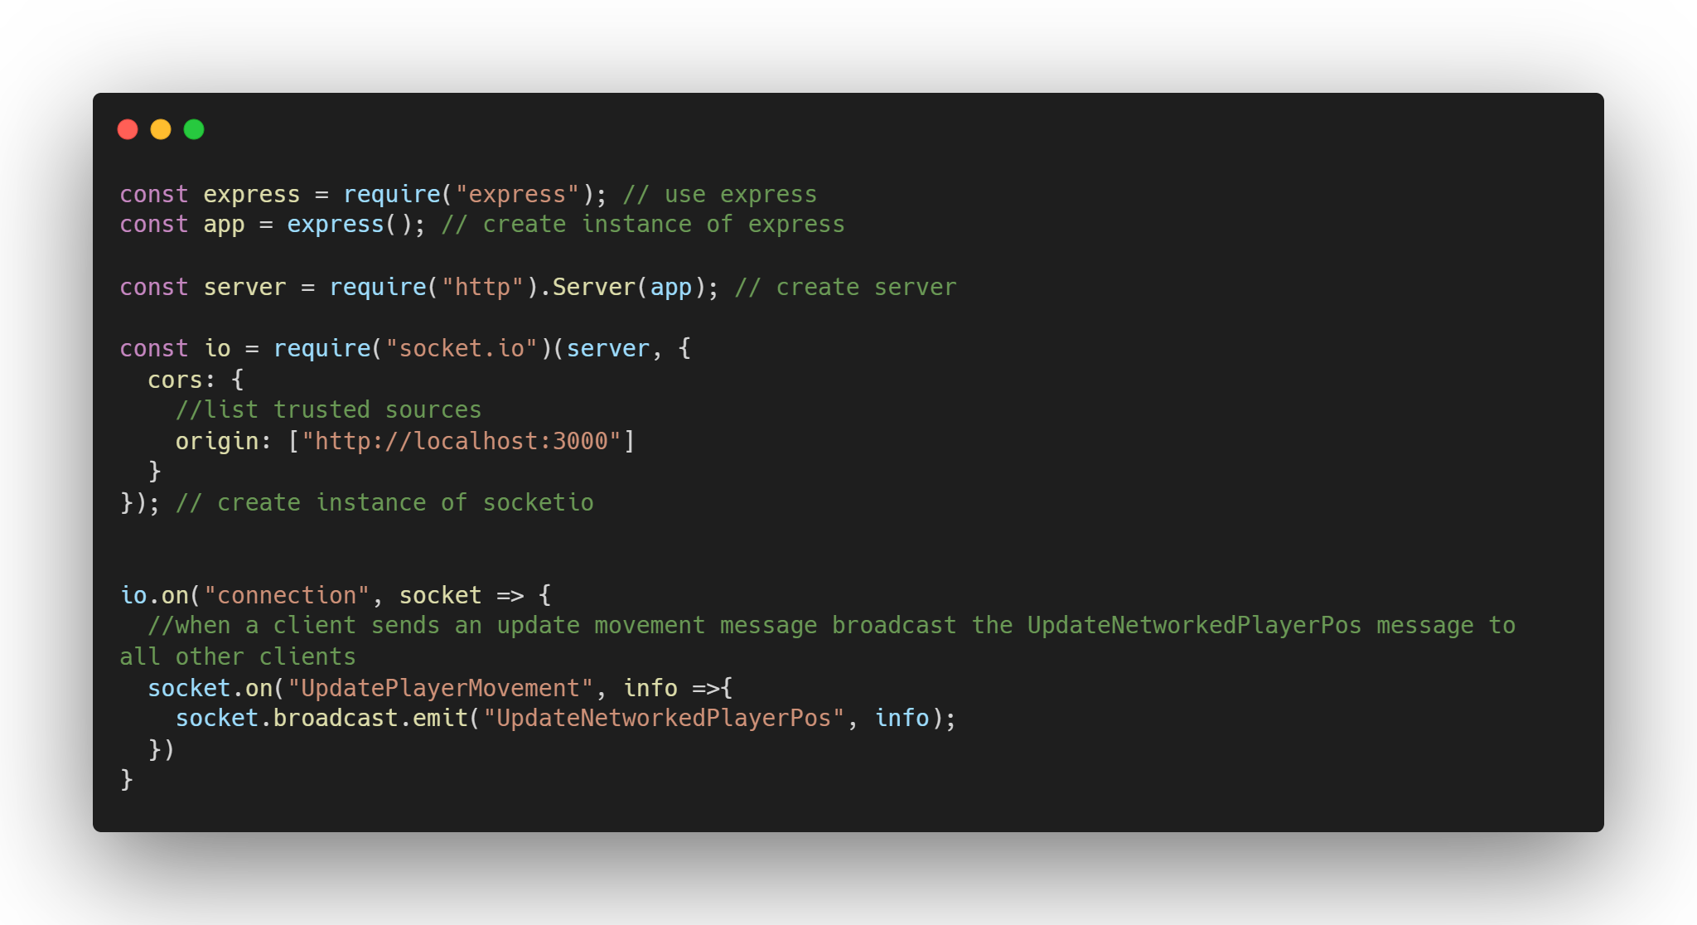
Multiplayer code server receiving client movement
Here is an abstracted version of the server.js
Server setup
Then the server listens out for a message of UpdatePlayerMovement sent by a client. When the message is received an UpdateNetworkedPlayerPos message is sent to all clients except sender

Slide 27
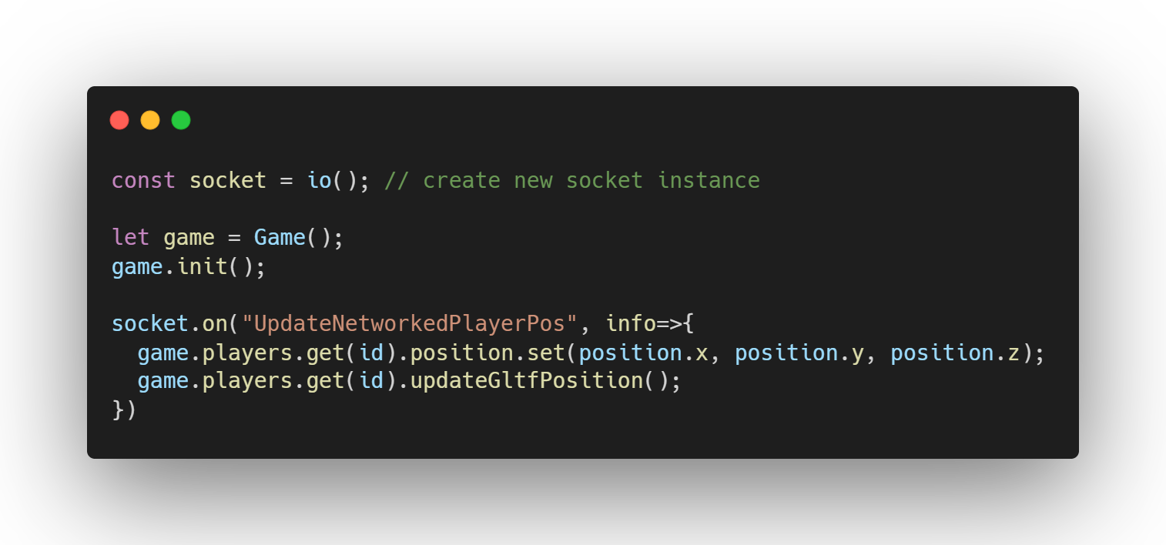
Multiplayer code client receiving other player movement
When a client receives an UpdateNetworkedPlayerPos message it means one of the networked players have moved and needs to be updated on this clients game
Info is an object containing the id of the player to move (the enemy player) and the position to move them to.
So when the message is received the player corresponding to the id’s position is updated along with their gltf model

